Slide 1
Software Development Life Cycle

Slide 2
Software Development Life Cycle
The UML is largely process-independent i.e, it is not tied to any particular software development life cycle.
To get the most benefit from the UML, you should consider a process that is -
Use case driven
Architecture-centric
Iterative and incremental

Slide 3
1. Use case driven
Use case driven means that use cases are used as a primary artifact for establishing the desired behavior of the system, for verifying and validating the system's architecture, for testing, and for communicating among the stakeholders of the project.

Slide 4
2. Architecture-centric
Architecture-centric means that a system's architecture is used as a primary artifact for conceptualizing, constructing, managing, and evolving the system under development.

Slide 5
3. Iterative and incremental
An iterative process is one that involves managing a stream of executable releases.
An incremental process is one that involves the continuous integration of the system's architecture to produce these releases, with each new release embodying incremental improvements over the other.
An iterative and incremental process is risk-driven, i.e each new release is focused on attacking and reducing the most significant risks to the success of the project.

Slide 6
Software Development Life Cycle
The use case driven, architecture-centric, and iterative/incremental process can be broken into phases.
A phase is the span of time between two major milestones of the process, when a well-defined set of objectives are met, artifacts are completed, and decisions are made whether to move into the next phase.

Slide 7
Software Development Life Cycle
There are four phases in the software development life cycle:
Inception Phase
Elaboration Phase
Construction Phase
Transition Phase
In the below diagram, workflows are plotted against these phases, showing their varying degrees of focus over time.

Slide 8
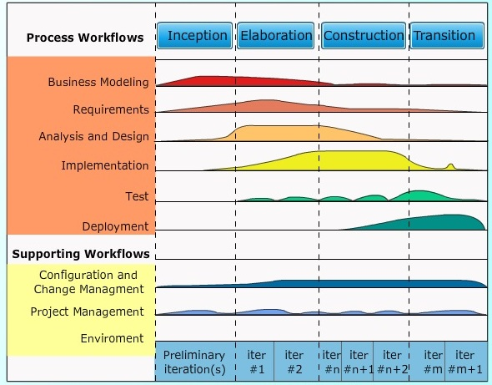
Software Development Life Cycle
Fig: Software Development Life Cycle

Slide 9
1. Inception Phase
Inception is the first phase of the process, when the seed idea for the development is brought up to the point of being - at least internally - sufficiently well-founded to warrant entering into the elaboration phase.

Slide 10
2. Elaboration Phase
Elaboration is the second phase of the process, when the product vision and its architecture are defined.
The system's requirements are articulated, prioritized, and baselined.
A system's requirements may range from general vision statements to precise evaluation criteria, each specifying particular functional or nonfunctional behavior and each providing a basis for testing.

Slide 11
3. Construction Phase
Construction is the third phase of the process, when the software is brought from an executable architectural baseline to being ready to be transitioned to the user community.
The system's requirements and especially its evaluation criteria are constantly reexamined against the business needs of the project, and resources are allocated as appropriate to actively attack risks to the project.

Slide 12
4. Transition Phase
Transition is the fourth phase of the process, when the software is turned into the hands of the user community.
Rarely does the software development process end here, for even during this phase, the system is continuously improved, bugs are eradicated, and features that didn't make an earlier release are added.

